Slide 1
VMware New PPT Icons
September 2014
Notes:
VMware believes that IT organizations need to move to a software-defined approach to cost-effectively and competitively serve internal and external customers.
I would like to give you a brief overview of VMware’s strategy for helping IT organizations become more efficient and responsive, and what this means to you and your business.

Slide 2

The Software-Defined Data Center
Expand virtual compute to all applications
Transform storage by aligning it with app demands
Virtualize the network for speed and efficiency
Management tools give way to automation
Notes:
The Software-Defined Datacenter has 4 key components:
Virtualization of compute for all applications
Virtualize network
Management for automation
And finally – the last leg of the stool – storage

Slide 3








Compute
Network
Storage
Mgmt.

Slide 4







On Demand Access
Desktop as a Service
Ease of Use
Less Complexity
End Users
End User Freedom
Mobile Cloud
Next Generation Apps
Cloud
Hybrid Cloud
Hybrid Cloud
Any Cloud,
Any Platform

Slide 5








Dev/Test
Management
Packaged Application
Disaster Recovery
New Enterprise Applications
Automation
Automated Operations
Automation
Automated Operations
Security
Platform as a Service

Slide 6
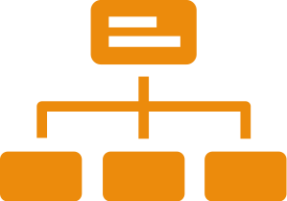









Database
as a Service
Mobile Devices
IT Control
Devices
Client Server
Desktop
Client Server
Datacenter
Data
Apple Device
Android
Device
Windows Device

Slide 7

Hadoop
App
Data
Policy
Identity
Application Diversity
Usability Expectations
24/7 SLAs

Slide 8


Reduces Costs
Cost
Cost Transparency
Cost Savings

Slide 9







Config
Memory
VMDK
Swap
Snapshot
Data
Version 1
Data
Version 2

